Slide 1
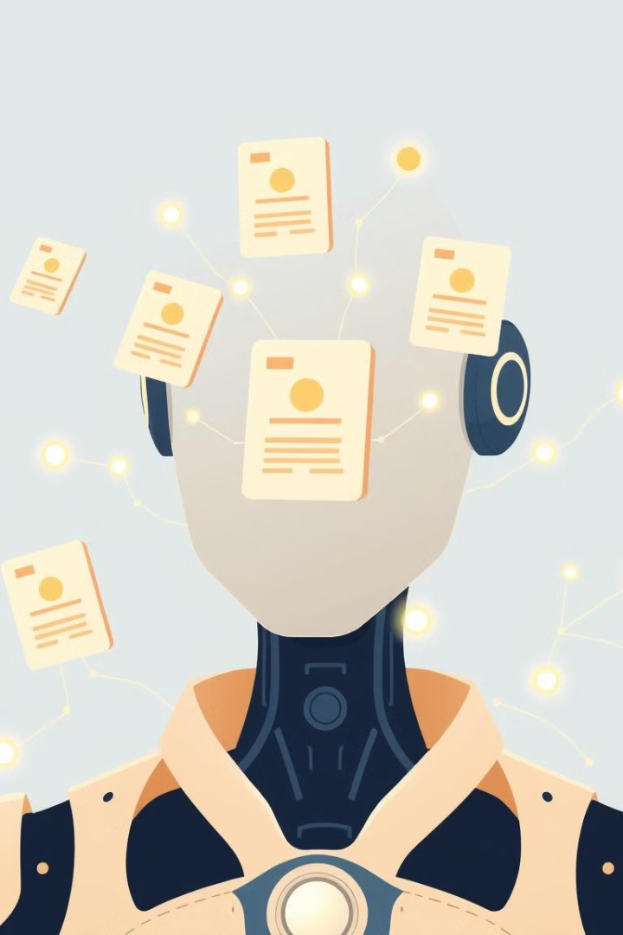

Resume Screening Project
Categorizes resumes and recommends jobs using machine learning.
Utilizes Random Forest Classifier and TF-IDF for text analysis.
by Shalini Patel

Slide 2
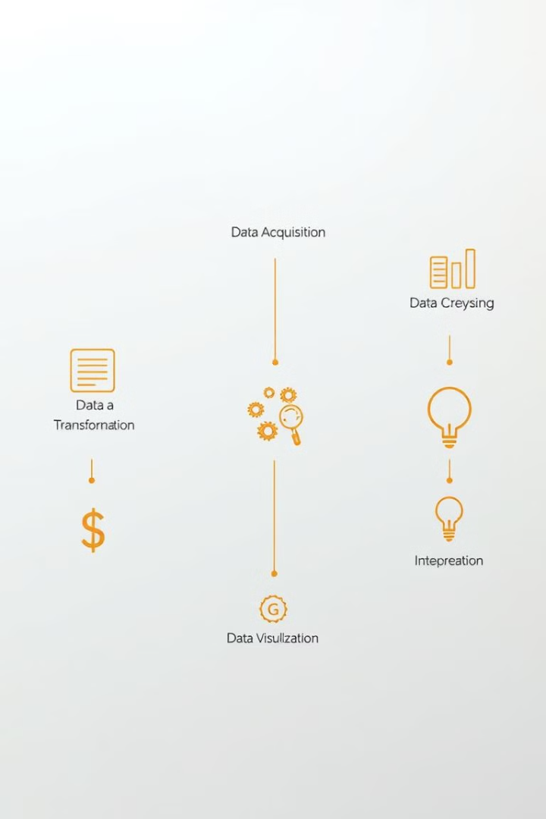




Project Workflow
Data Collection
Gathered resume data with job roles and features.
Preprocessing
Filtered and balanced dataset to avoid class imbalance.
Model Training
Used text vectorization and classification for job roles.
Evaluation
Tested accuracy and deployed for real-world application.

Slide 3
Data Preprocessing and Balancing
Goal
Steps
Result
Ensure balanced representation of job categories.
Counted instances, resampled data to maximum category count.
Balanced dataset ready for effective model training.

Slide 4

Text Vectorization Using TF-IDF
1
Purpose
Transform resume text into numerical form.
2
Process
Fit vectorizer on training data, build vocabulary.
3
Transform
Convert training and testing data to TF-IDF matrices.
4
Outcome
Provide input features for machine learning models.

Slide 5

Random Forest Classifier
1
Model Choice
2
Training
Ensemble model combining multiple decision trees.
Used balanced, TF-IDF-transformed text data.
3
Categorization
4
Advantages
Learned to classify resumes based on features.
Handles large datasets, reduces overfitting, high accuracy.

Slide 6

Model Evaluation Metrics
Metric
Purpose
Accuracy Score
Overall performance on test data
Classification Report
Precision, Recall, F1-Score per category
Confusion Matrix
Visual representation of predictions

Slide 7
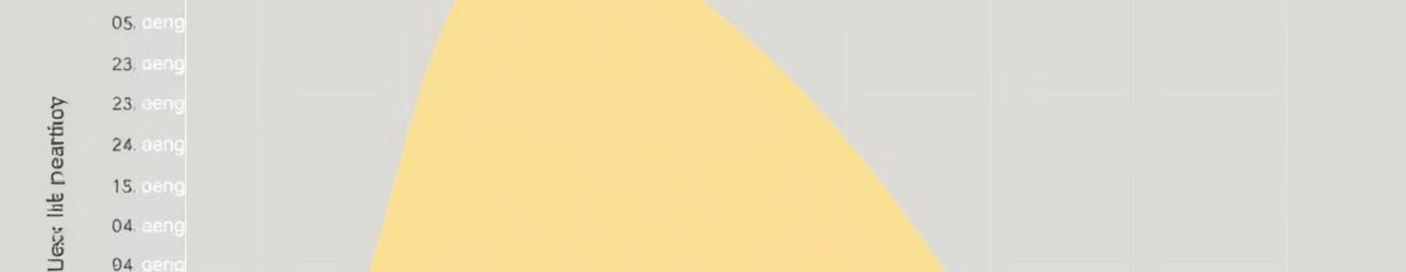
Confusion Matrix Analysis
Visualization
Highlights
Interpretation
Heatmap of true vs. predicted labels.
Shows model's strengths and areas for improvement.
Guides further model tuning and refinement.

Slide 8




Model Persistence with Pickle
Save Models
Store trained model and TF-IDF vectorizer.
Future Use
Facilitate usage without retraining.
Deployment
Enable quick job role prediction in applications.

Slide 9
Conclusion and Future Work
Summary
Enhancements
Applications
Developed resume screening system with advanced ML techniques.
Explore deep learning, integrate additional features.
Automate HR systems for resume screening, job recommendations.

